Slide 1

Pharmacy Management System (Desktop Application)
International Islamic University Chittagong
Presented By: Coders47
1. Afridi Rahman-C201045
2. Syed Mahmoud Sobhani-C201134
3. Mohammed Sakib Khan-C201068
Dept. of CSE (4BM)

Slide 2

Introduction
This is a desktop application for pharmacy management system for a famous pharmacy called Avicenna Pharmacy.
Through this application, a user can do all the works to maintain a pharmacy from selling medicine to
checking medicine expiration dates within a few clicks.
Avicenna Pharmacy ®

Slide 3
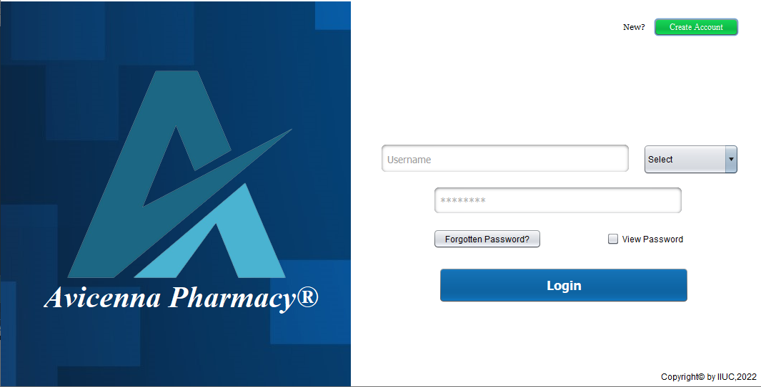
Login Page
This is the login page of the application where easy interface and perfect security has been maintained. Also, this page has create an accout option to add new user . While login in a user must select his/her role so that the program can take him/her to destination page.

Slide 4
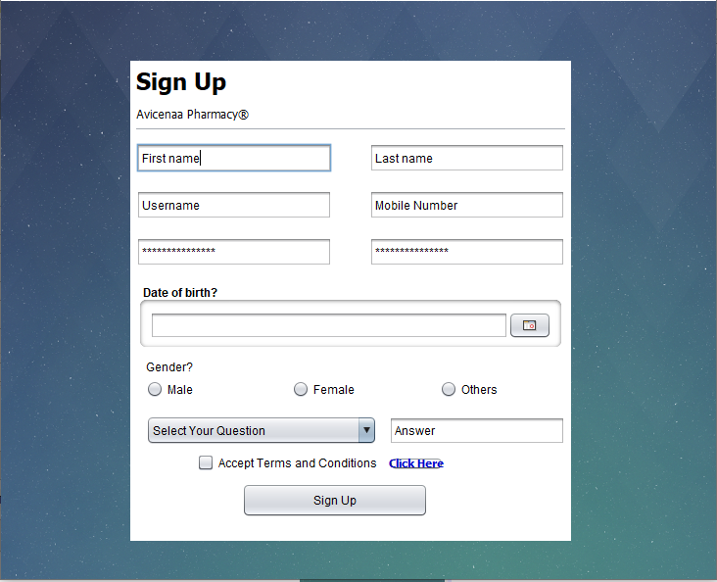
Create Account
This is basically the signup page. Here the user must answer a security question to save its account incase of he/she forgot the password.
There is also a term and conditions page made by Avicenna company.

Slide 5
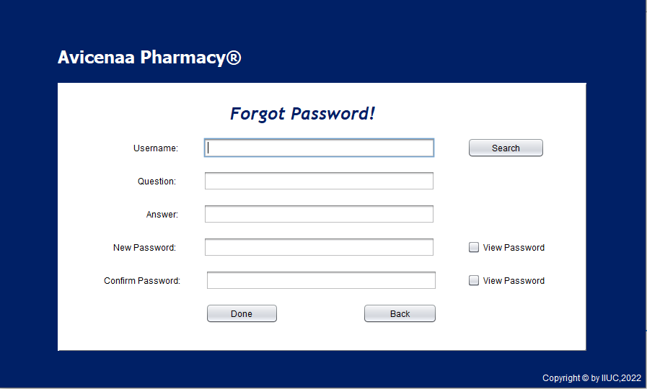
Forgot Password
This is the forgot password panel where a user comes if he/she forgot the password. To obtain user account, he/she must go through 2 security options.
1. Writing valid username.
2. Answering the security question that the user answered when making his/her account.

Slide 6
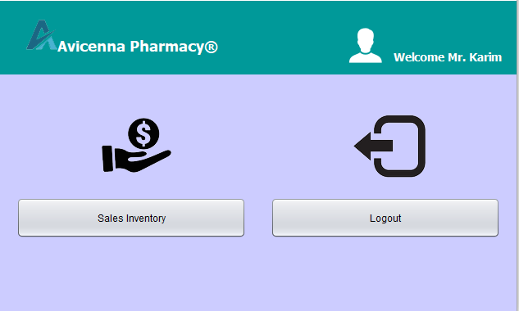
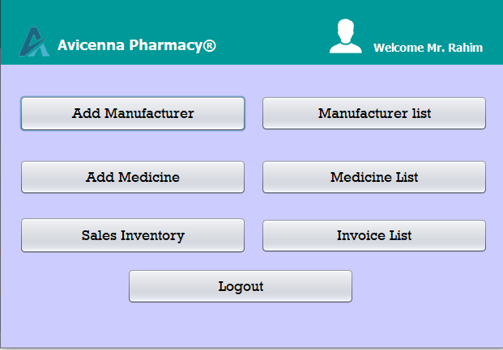
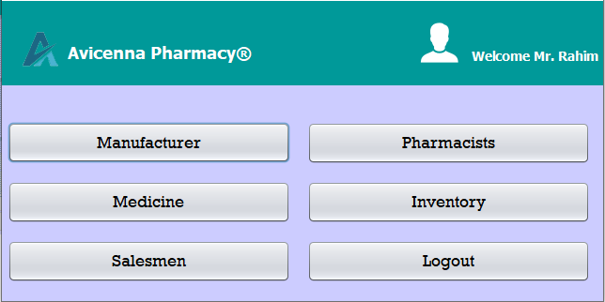
Dashboards
This is a simple multi-optional dashboards for an admin or a pharmacist or a salesman. All the user can move through this button and also they can logout from their account.

Slide 7
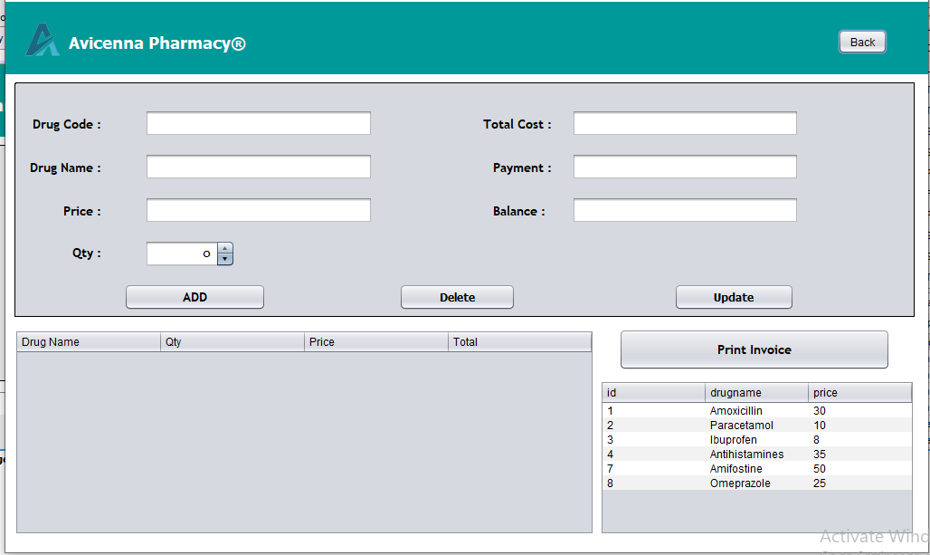
Sales Inventory
This page is one of the main attraction of the application. There are many reasons behind that. Firstly, here a user can find the drug by writing its code only.
Secondly, app will count the price according to the qty and paste it in the table of invoice. Finally, when the user click the print option, a pdf will be opened automatically.

Slide 8
Others
In conclusion, In this application our goal was to make management system of any pharmacy system simple and effective.
We used Xampp as database collector with a vast number of storage for the datas that will be given through the application.
Every code is easy to understand for a normal engineer so that he/she can easily solve the bug(If found any).
The application has user defined option for each type of user.
A weekly update or checkup will be given to the company that owns this application for more features.

Slide 9

Thank you

